Slide 1

Bank Loan Case Study
Sumeet Dutta

Slide 2
CONTENTS
Project Description
Project Approach
Tech-Stack Used
Objectives
Insights or Approach
Results

Slide 3
PROJECT DESCRIPTION
This project aims to understand and analyse the loan risk of a financial company. When a applicant applies for loan, the company faces two risk:-
If the applicant can repay the loan but is not approved, the company loses business.
If the applicant cannot repay the loan and is approved, the company faces a financial loss.
The main objective of this project is to identify the pattern that indicate if a applicant have difficulty paying their installments. This information can be used to make decision such as denying or accepting a loan request, reducing the amount of loan, or lending at a higher interest rate to risky applicants.
The company wants to understand the key factors behind loan default so it can make better decisions about loan approval.

Slide 4
PROJECT APPROACH
This project required a strong understanding of advanced Excel techniques and statistical calculations. The dataset provided contained missing values and outliers, which could significantly impact the analysis and lead to inaccurate conclusions if not properly addressed.

Slide 5
TECH-STACK USED
The tech-stack used for this project includes Microsoft Excel, to analyse and visualise the data, and Microsoft PowerPoint to present the analysis.

Slide 6
OBJECTIVES
Identify Missing Data and Deal with it Appropriately
Identify Outliers in the Dataset
Analyse Data Imbalance
Perform Univariate, Segmented Univariate, and Bivariate Analysis
Identify Top Correlations for Different Scenarios

Slide 7
TASK 1:- Identify Missing Data and Deal with it Appropriately
Task:- Identify the missing data in the dataset and decide on an appropriate method to deal with it using Excel built-in functions and features.
Approach:- To find the missing data in the dataset I used COUNTA function to count the total number of row in the columns. Then I calculated the percentage of null value in column using the formula:- (Total no. of non-null rows/ Total no. of rows)*100. After that, I generated a new table containing only the columns with less than 30% missing data. For these columns, I imputed the missing values by replacing them with the column's average.

Slide 8
TASK 2:- Identify Outliers in the Dataset
Task:- Detect and identify outliers in the dataset using Excel statistical functions and features, focusing on numerical variables.
Approach:- I identified the outliers by applying the QUARTILE and INTERQUARTILE RANGE (IQR) method, focusing on the relevant variables.

Slide 9
OUTLIER IN THE COLUMN AMT_INCOME_TOTAL
In this XY scatter plot, we observe one applicant with a total income of 11 crores under target 1, while the majority of applicants have incomes in the lakh range. This particular value stands out as a clear outlier.

Slide 10
OUTLIER IN THE COLUMN AMT_CREDIT
In this XY scatter plot, the maximum credit amount for target variable 0 is 40 lakhs, and for target variable 1, it is 29 lakhs. Both values fall within a reasonable range, indicating that there are no significant outliers in the AMT_CREDIT column.

Slide 11
OUTLIER IN THE COLUMN CNT_CHILDREN
In this XY scatter plot, target variable 1 shows a maximum of 11 children, followed by 9, which seems implausible. Similarly, target variable 0 has a maximum of 8 children, which also appears unrealistic. Therefore, these values can be considered outliers in the dataset.

Slide 12
OUTLIERS IN THE COLUMN DAYS_EMPLOYED(YRS)
In this XY scatter plot, we observe an applicant with an employment duration of 1001 years in both target 1 and target 0, which is clearly impossible. These values are definitely outliers.

Slide 13
TASK 3:- ANALYSE DATA IMBALANCE
Task :- Determine if there is data imbalance in the loan application dataset and calculate the ratio of data imbalance using Excel functions.
Insight:- The ratio of data imbalance in the application_data of applicants who made payment on time i.e. target 0 to the applicants who had payment difficulty i.e. target 1 is 11:1.
Out of 49999 total applicants, the percentage of applicants with payment made on time is 92% and the applicants with payment difficulty is 8%.

Slide 14
TASK 4:- PERFORM UNIVARIATE, SEGMENTED UNIVARIATE, AND BIVARIATE ANALYSIS
Task:- Perform univariate analysis to understand the distribution of individual variables, segmented univariate analysis to compare variable distributions for different scenarios, and bivariate analysis to explore relationships between variables and the target variable using Excel functions and features.
Approach:- To perform Univariate, Segmented Univariate and Bivariate analysis, I first created bins of AMT_INCOME_TOTAL with the range of 50,000 and AMT_CREDIT with the range of 1 Lakh.

Slide 15
UNIVARIATE ANALYSIS FOR AMT_INCOME_TOTAL
This graph represents the univariate analysis, showing the count of applicants (both 0 & 1) in the AMT_INCOME_TOTAL column, grouped into bins of 50,000.
The majority of loan applicants have an income in the range of 2,00,001 to 2,50,000.

Slide 16
UNIVARIATE ANALYSIS FOR AMT_CREDIT
This graph represents the univariate analysis, showing the the count of applicants (both 0 & 1) in the AMT_CREDIT column, grouped into bins of 1,00,000.
The majority of loan applicants request loans in the range of 2,00,001 to 3,00,000.

Slide 17
SEGMENTED UNIVARIATE ANALYSIS FOR AMT_INCOME_TOTAL
This graph represents the segmented univariate analysis, showing the count of applicants with different contract status- approved, cancelled, refused and unused offer- in the AMT_INCOME_TOTAL column, grouped into bins of 50,000.
The majority of applicants with approved loans fall within the income range of 1 Lakh to 1.5 Lakh.

Slide 18
SEGMENTED UNIVARIATE ANALYSIS FOR AMT_CREDIT
This graph represents the segmented univariate analysis, showing the count of applicants with different contract status- approved, cancelled, refused and unused offer- in the AMT_CREDIT column, grouped into bins of 1,00,000.
Most applicants with approved loans have a credit amount in the range of 2 lakh to 3 lakh.

Slide 19
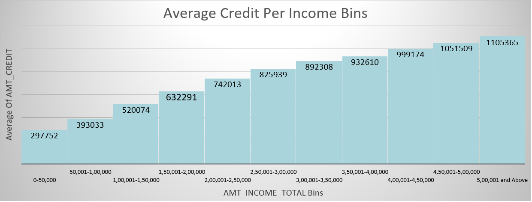
BIBARIATE ANALYSIS
The graph above represent the relationship between applicants and their total income bins, showing a direct proportionality.
As total income increases, there is a parallel rise in the credit amount requested.

Slide 20
TASK 5:- IDENTIFY TOP CORRELATION FOR DIFFFERENT SCENARIOS
Task:- Segment the dataset based on different scenarios (e.g., clients with payment difficulties and all other cases) and identify the top correlations for each segmented data using Excel functions.
Approach:- To perform correlation analysis for different scenarios, I created two separate tables: one for target 0 and another for target 1. In each table, I included the columns I wanted to analyze for correlation.

Slide 21
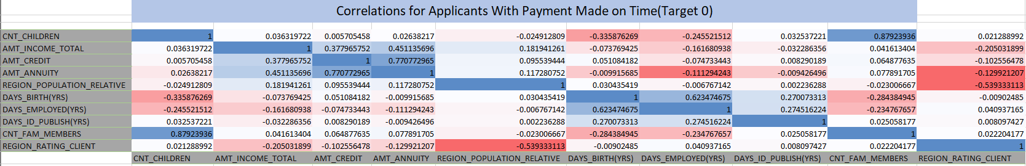
CORRELATION FOR APPLICANTS WITH PAYMENT MADE ON TIME
The heatmap above shows the correlation between different variables for target 0, representing applicants who made payments on time.
The colors range from blue, indicating the strongest correlation, to red, indicating the weakest.
The most relevant correlations are:- CNT_CHILDREN TO CNT_FAM_MEMBERS, AMT_CREDIT TO AMT_ANNUITY, DAYS_BIRTH(YRS) TO DAYS_EMPLOYED(YRS)

Slide 22
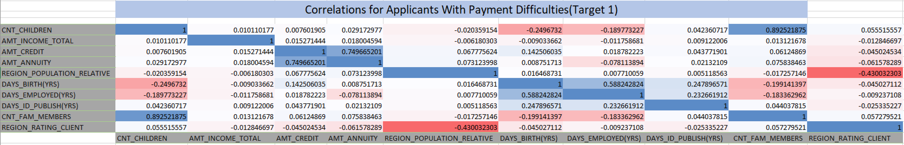
CORRELATION FOR APPLICANTS WITH PAYMENT DIFFICULTIES
The heatmap above shows the correlation between different variables for target 1, representing applicants with payment difficulties.
The colors range from blue, indicating the strongest correlation, to red, indicating the weakest.
The most relevant correlations are:- CNT_CHILDREN TO CNT_FAM_MEMBERS, AMT_CREDIT TO AMT_ANNUITY, DAYS_BIRTH(YRS) TO DAYS_EMPLOYED(YRS)

Slide 23
RESULTS
There is a substantial amount of missing data in the dataset that could hinder the analysis, so it is essential to resolve these issues before utilizing the data, just as I have done.
There are several outliers in the data that could significantly disrupt the analysis, so it is crucial to address them appropriately before proceeding with the analysis.
Most applicants do not have payment difficulties and make their payments on time, while only a small number of applicants face payment difficulties.
Applicants with higher total income tend to request higher credit amounts, showing a proportional relationship between income and credit amount.

Slide 24
THANK YOU
Link to the dataset:-
https://docs.google.com/spreadsheets/d/1KfWuEizKUlglUFcZTBQMgVqAtSz_1xh7/edit?usp=sharing&ouid=100462539858177935973&rtpof=true&sd=true

